Slide 1


Campus Navigation System at Chanakya University
An Intelligent Pathfinding Solution for Easy Navigation
BY
Gagan T

Slide 2

Overview of the Project
Content: Chanakya University offers a large campus with multiple buildings and departments, making it challenging for visitors and students to navigate efficiently.
This project focuses on developing a Campus Navigation System to help users navigate the campus and find their way using various pathfinding algorithms.
The system provides walking directions from one location to another, displaying a detailed path with estimated time and distance.

Slide 3
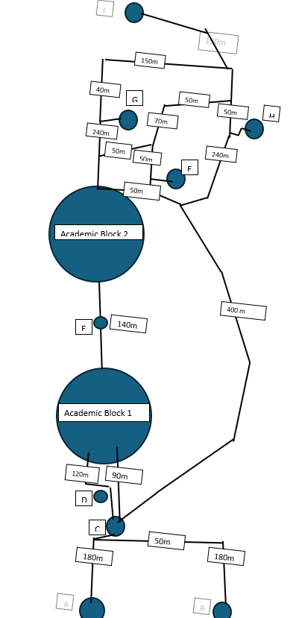
Campus Map and Graph
Campus Map & Graph Representation
Content:
The campus graph represents various buildings and their connections, where each location is a node, and each path between them is an edge with distance and speed.
Graph Representation Example:
Entry Gate Security Gate Flag Post Academic Block 1 Entrance Library
A=ENTRY GATE B=EXIT GATE
C= SECURITY GATE
D=FLAG POST
E=LAWN AREA
F= HOSTEL BUILDING 2
G= FOOD COURT
H=HOSTEL BUILDING 1
I=CRICKET GROUND

Slide 4
Pathfinding Algorithms
Pathfinding Algorithms Explained
Content:
A Search:* Combines actual cost to reach a node and a heuristic estimate of the remaining cost (Euclidean distance) to efficiently find the shortest path.
UCS (Uniform Cost Search): Focuses on the total cost of reaching the destination, expanding paths with the least cost first.
BFS (Breadth-First Search): Explores all nodes level by level, ideal for unweighted graphs but may not always find the shortest path.
DFS (Depth-First Search): Explores as deeply as possible along one path before backtracking, which might not guarantee the shortest path but is computationally simple.

Slide 5
Algorithm Comparison
ALGORITHM | DESCRIPTION | EFFICENCY | IDEAL USE
A* | Finds shortest path using cost + heuristic. | Fast, Optimal | Long campus routes
UCS | Expands paths by minimum cost. | Medium | Cost-focused path
BFS | Explores all neighbors at the same level. | Slow | Unweighted graphs
DFS | Explores paths deeply before backtracking. | Slow | Depth-first exploration

Slide 6
Walking Time Calculation
Walking Time Estimation Formula
Walking time can be estimated using the following formula:
Time (minutes) = (Distance in meters) / (Walking Speed in m/s) × (1 / 60)
At Chanakya University, the average walking speed is approximately 1.35 meters per second (m/s), which has been slightly adjusted to reflect realistic campus walking speeds.
EXAMPLE:
If the distance between the Security Gate and Academic Block 1 Entrance is 220 meters, we can estimate the walking time as follows:
Time = (Distance) / (Walking Speed) × (1 / 60)
Time = 220 / 1.35 × (1 / 60)
Time ≈ 2.72 minutes
So, it would take approximately 2.72 minutes to walk from the Security Gate to Academic Block 1.

Slide 7
Campus Map on Leaflet
The campus map is visualized using Leaflet.js, a JavaScript library for interactive maps.
Features include: A custom map with campus building markers.
Step-by-step path visualization on the map.
Real-time updates of walking routes.

Slide 8
APIs:-
The backend is powered by Flask, serving a RESTful API that supports:
Building information retrieval
Pathfinding requests using selected algorithms
Real-time data such as distance, estimated walking time, and directions

Slide 9
Results and Directions
Path Output Details
After calculating the path, the system provides:
A list of locations to visit, in sequential order
The total distance and estimated walking time
Detailed, step-by-step directions for the route
Example: Path from Entry Gate to Academic Block 2
From Entry Gate, walk 200 meters to Security Gate.
Continue towards Flag Post for 60 meters.
Head to Academic Block 2 for 150 meters.

Slide 10
Conclusion
Campus Navigation System – Chanakya University
The Campus Navigation System at Chanakya University is a vital tool designed to help students, faculty, and visitors efficiently navigate the campus.
With features such as:
Integration of various pathfinding algorithms
An interactive map
Real-time directions and estimated walking times
Future upgrades will focus on enhancing functionality, ensuring the system remains relevant, user-friendly, and continuously improves the overall navigation experience.

Slide 11
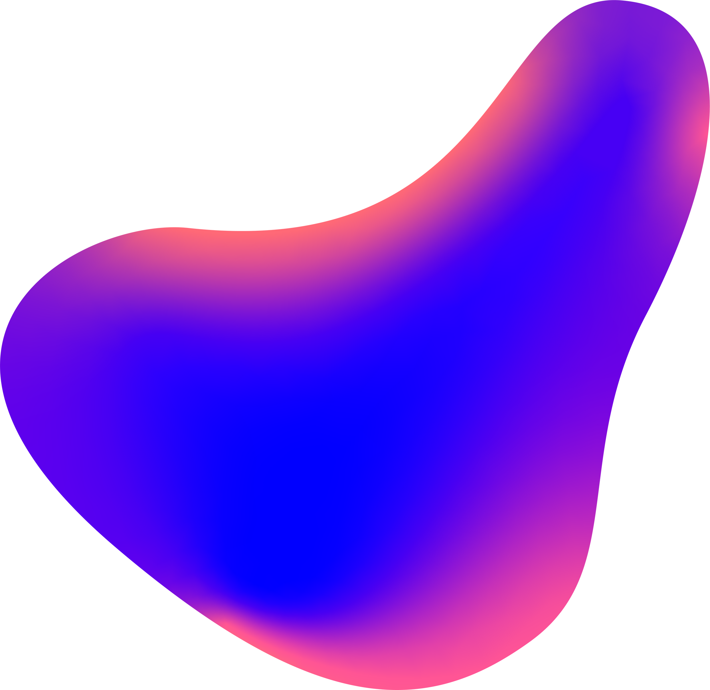
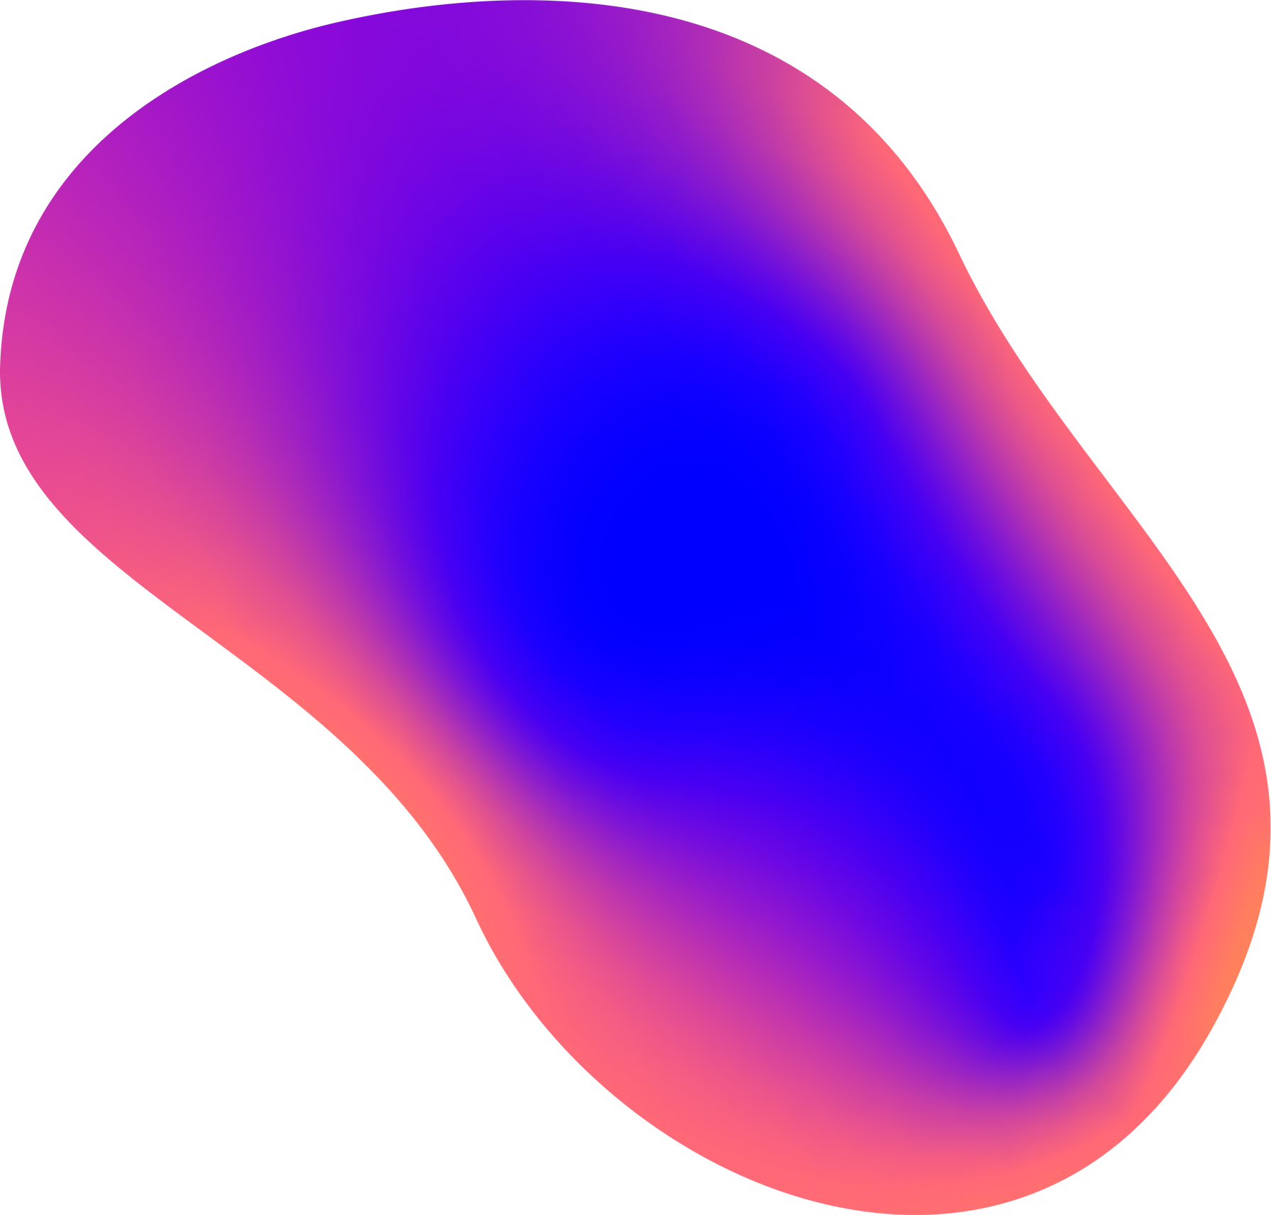
Thank You
NAME : Gagan T
REG NO : 24UG00311
GITHUB REPO:- github.com/gagankalyan39

